Slide 1
DEVELOPMENT OF A PRESCRIPTION DRUG SURVEILLANCE SYSTEM
Sponsor
James C. Benneyan
TEAM MEMBERS
Jenna Eickhoff
Benjamin Harris
Jeffrey Mason
Dan Mitus

Slide 2
Nonmedical use of prescription drugs are the third most abused illicit drugs in the nation
Numbers in millions
Source: National Survey on Drug Use and Health, 2006, Ages 12+

Slide 3
Prescription Drug Abuse Problem
“Prescription drug abuse has become an epidemic in MA”
-MA Commissioner, 2005
From 1990-2003,
opioid related deaths increased 600%
in MA
In 2006,
prescription drugs had the highest amount of new users
– 2.2 million users
From 1999-2002,
treatment admission for opioid abuse increased 950%
in MA

Slide 4
Analysis Methods
Public Health and Epidemiology analyze the rate of infection control, disease outbreaks, and medical errors through the following methods:
Over time (temporal)
Over a geographic area (spatial)
Over a geographic area over time (spatial-temporal)
Prescription drug data has not been systematically monitored by these methods

Slide 5
Analysis Methods
3 TYPE OF RATES THAT CAN
SIGNAL DRUG ABUSE:
Opioid Prescription
Rate
# of Opioid Prescriptions
# of Total Prescriptions
Doctor Shopping Rate
# of Multiple Doctors
# of Unique Patients
Overprescribing Rate
# of Patients with Excess Pills
# of Unique Patients

Slide 6
Goal Statement
Design and develop a quantitative surveillance system that will monitor and detect when and where the abuse of prescription opioids is likely to be occurring that will enable Massachusetts’ public health personnel to take corrective action in a timely manner.

Slide 7
Current Abuse Data Sources
Current systems are not…
  Designed to automatically detect changes
  Statistically advanced
  Geographically sensitive
  Real time
  User-friendly
National Survey on Drug Use and Health
Drug Abuse Warning Network
Schedule II Prescription Monitoring Program (PMP)
Drug Evaluation Network System (DENS)

Slide 8
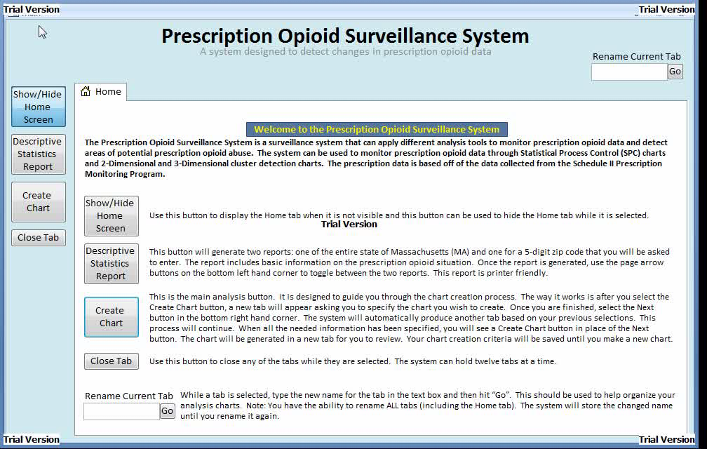
Database Design
Graphical User Interface Demonstration
Built in MS Access
Data imported from the MA PMP
Easy-to-use Graphical User Interface (GUI)
Built in statistical methods

Slide 9
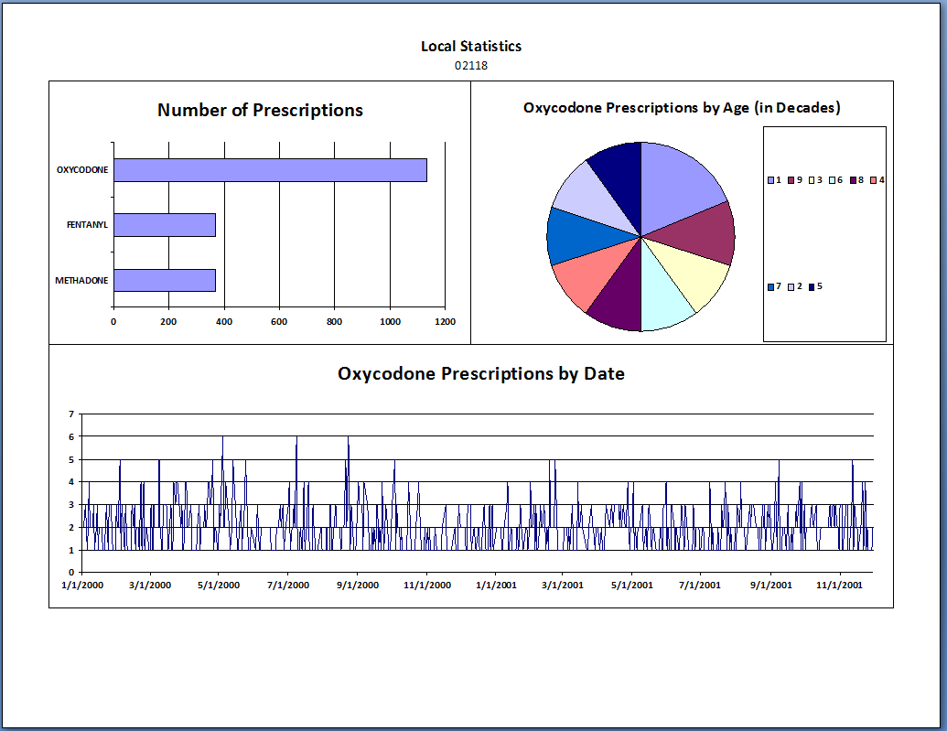
Descriptive Statistics
Can be generated for all of MA and for a zip-code of choice
Printer friendly report

Slide 10
Temporal Analysis
Used Statistical Process Control (SPC) charts to monitor the different data types and to detect when the rate is changing
Standardized p-chart
Out-of-control points signal possible drug abuse
Upper Control Limit (UCL)
Center Line (CL)
Where:
F_{t} = sample std. rate
p = target rate
n_{i} = sample size
Lower Control Limit (LCL)

Slide 11
Temporal Analysis
Implemented advanced SPC methods to:
Make the system more sensitive to small changes
Filter out noise
Exponentially Weighted Moving Average Chart (EWMA)
Able to detect shifts less than 1.5σ by…
…placing more importance on the most recent observations

Slide 12
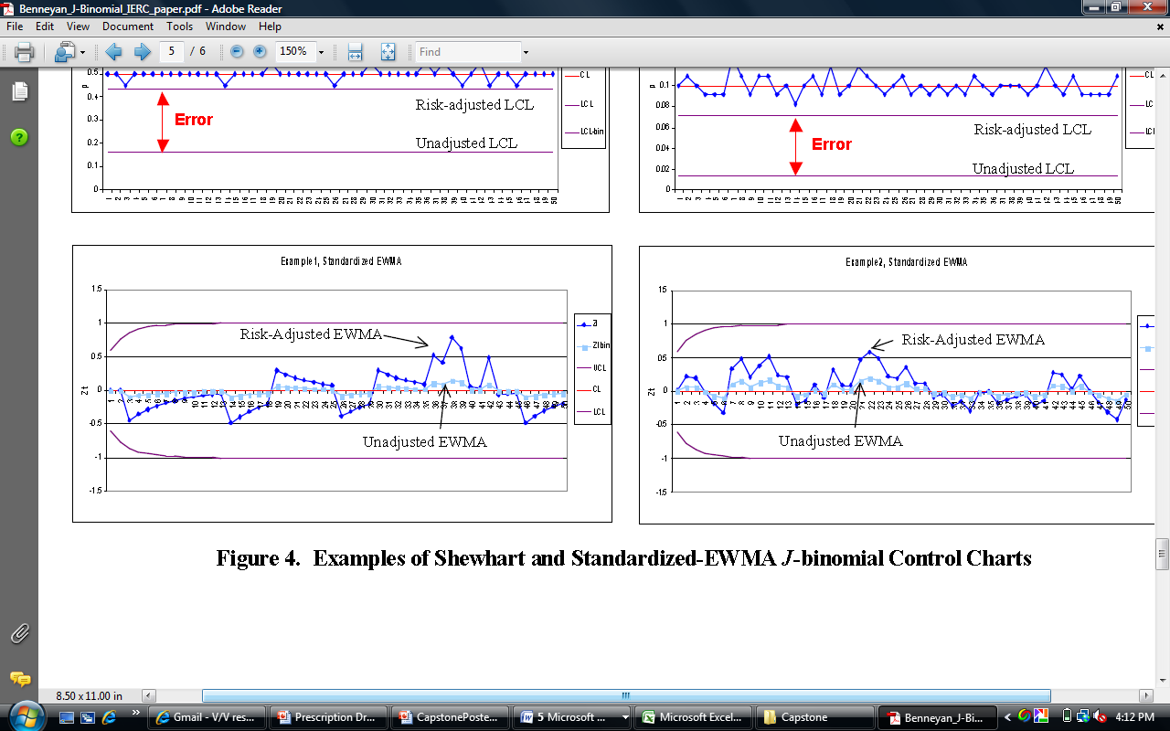
Temporal Analysis
Risk Adjustment
Prescription drug data is heterogeneous:
Men are more likely than women to abuse prescription drugs
Persons 18-20 are more likely to abuse prescription drugs than other age groups
Not accounting for the different prescription rates increases the chance for error

Slide 13
Temporal Analysis
Implemented advanced SPC methods to:
Account for seasonality
Account for differences in population and location
Risk Adjusted Chart
Accounts for multiple subgroups by…
…taking the standardized statistic…
…and accounting for each subgroup’s unique rate and variance

Slide 14
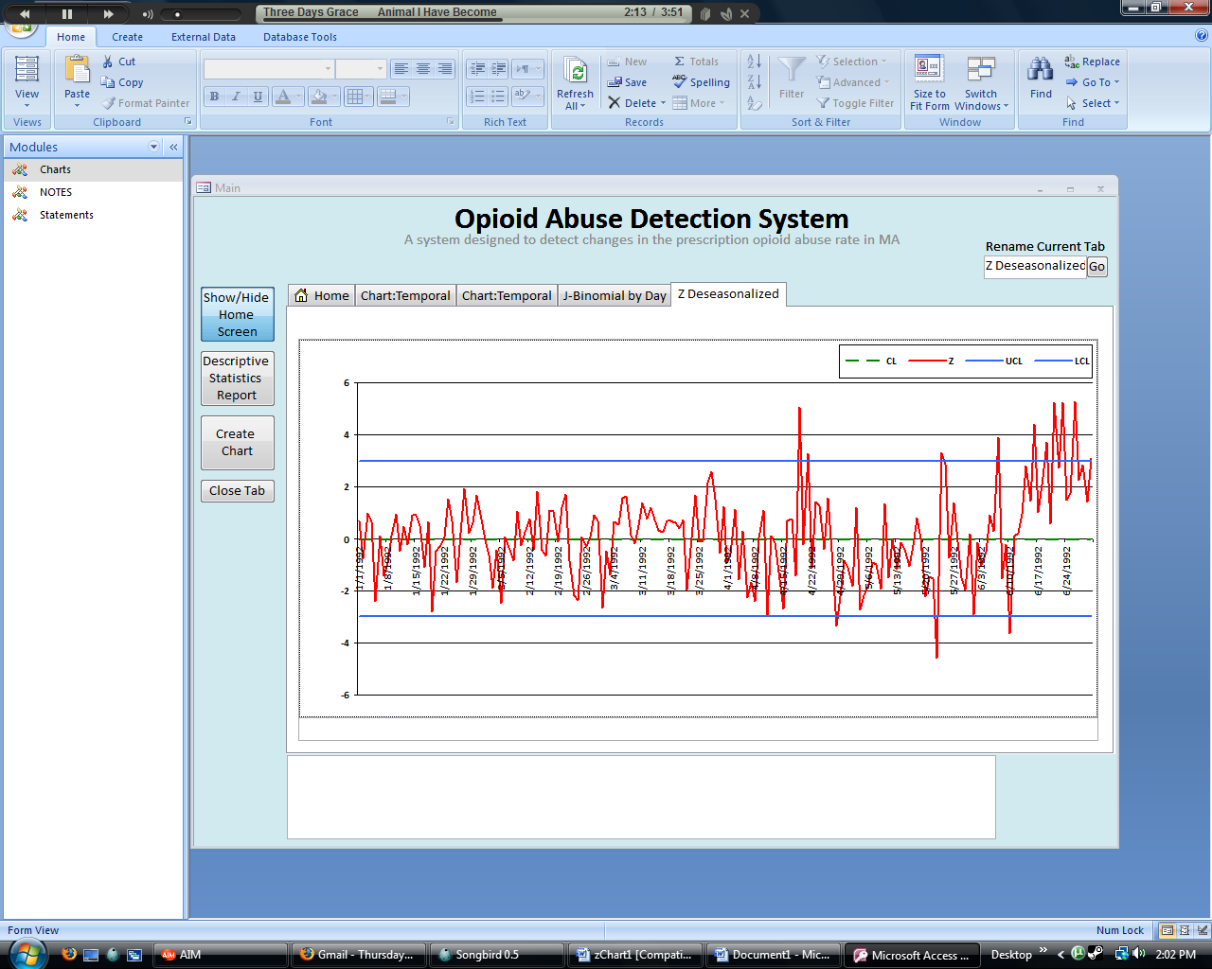
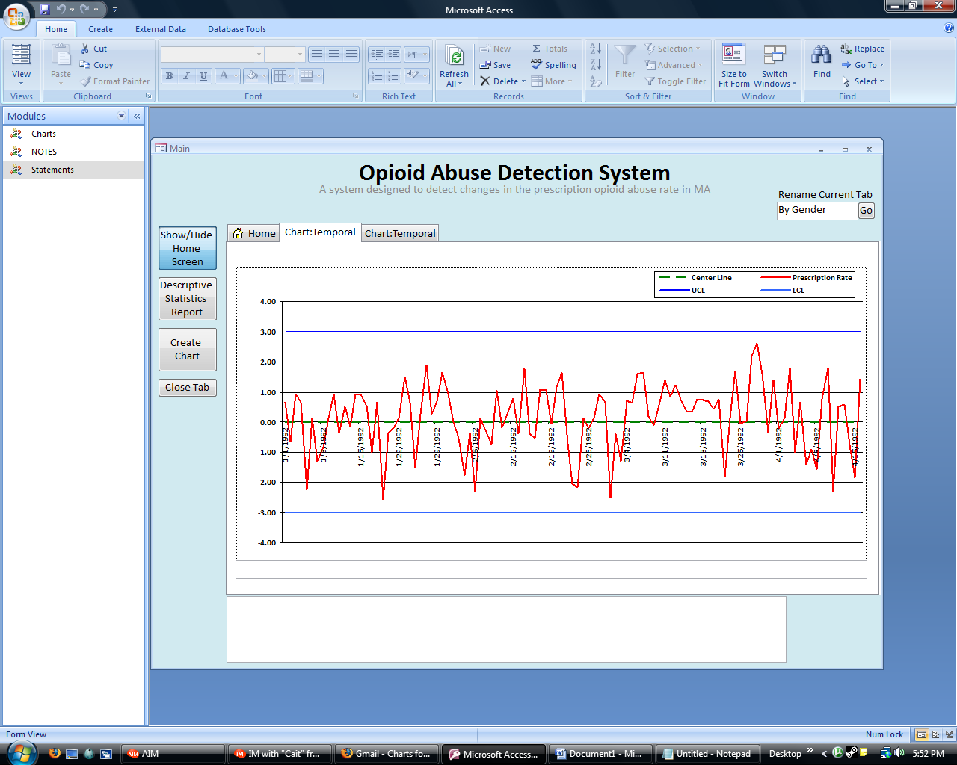
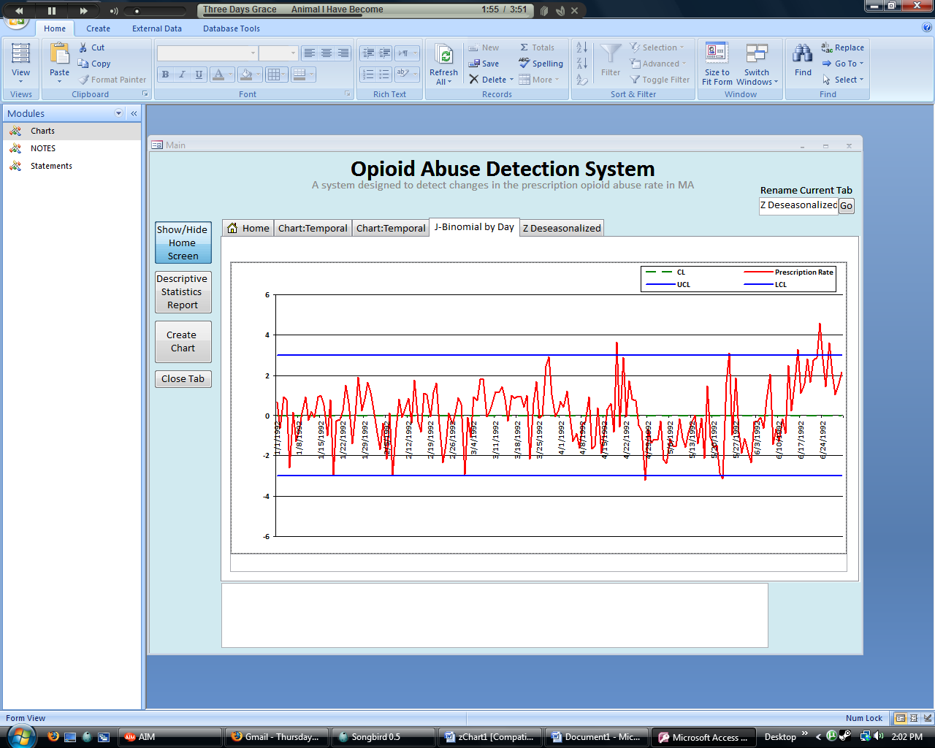
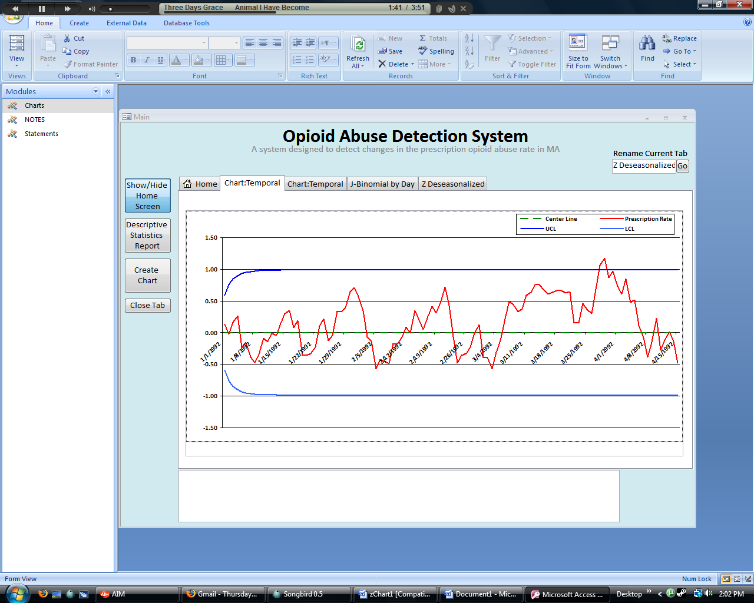
Temporal Results
Example of Risk Adjustment accounting for the seasonality in the opioid prescribing rate
Example of EWMA detecting a smaller process change in the opioid prescribing rate
In Control
Standardized p-Chart
Standardized p-Chart
Out-of-Control
Standardized Risk Adjusted Chart
Standardized EWMA Chart

Slide 15
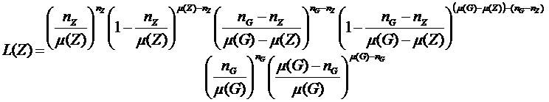
Spatial Analysis
Determine the radius size and
the maximum likelihood through
Kuldorff’s SCAN Statistic L(Z)
Where:
N_{z} = the number of data points in search area Z
µ(z)= the number of applicable incidences in search area Z
N_{G} = the number of data points in the population (sample space G)
µ(G)= the number of applicable incidences in the population (G)

Slide 16
Spatial Analysis
Determine the radius size and
the maximum likelihood through
Kuldorff’s SCAN Statistic L(Z)
(73,42.1)
Radius = 20
L(Z) = 17
X | Y | R | L(Actual) | P
73
42.1
20
17

Slide 17
Spatial Analysis
Determine the radius size and
the maximum likelihood through
Kuldorff’s SCAN Statistic L(Z)
(72.75, 42.65)
Radius = 4
L(Z) = 120
X | Y | R | L(Actual) | P
?
73
42.1
20
17
72.75
42.65
4
120
73

Slide 18
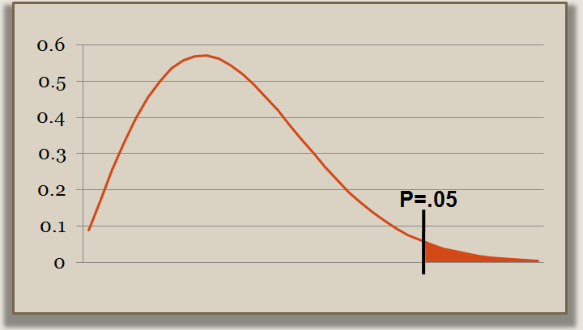
Spatial Analysis
Most distributions are known,
making it easy to determine if a sample is significant…
But our data has an unknown distribution…
We do a Monte Carlo Simulation to determine significance

Slide 19
Spatial Analysis
and find the significance threshold
Generate the likelihood
10,000 times….
Probability
P=.05
Likelihood

Slide 20
Spatial Analysis
X | Y | R | L(Actual) | P
73 42.1 20
17
.002
72.75 42.65 4
120
.28
Not a Significant Cluster!
Significant Cluster!
P=.28
P=.002

Slide 21
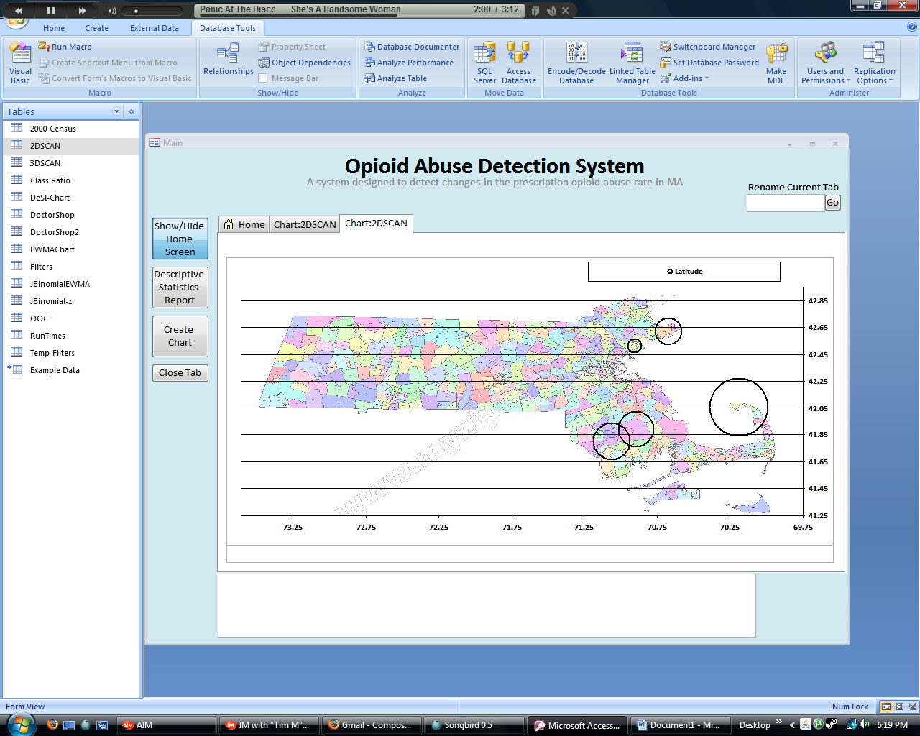
Spatial Analysis
Analysis performed for every 5-digit zip code in MA
Areas with significant prescription opioid abuse rates will be detected and identified

Slide 22
Spatial-Temporal Analysis
X | Y | T | R | L(Actual)
January
73
42.1
1
20
17
February
73
42.1
2
14
115
March
73
42.1
3
29
78
April
…
…
4
…
…
May
…
…
5
…
…
T | Zip | R | L(Actual) | P-Value
1
02101
20
17
.002
3
02215
31
22
.005
5
01865
8
39
.019
2
02634
14
56
.022

Slide 23
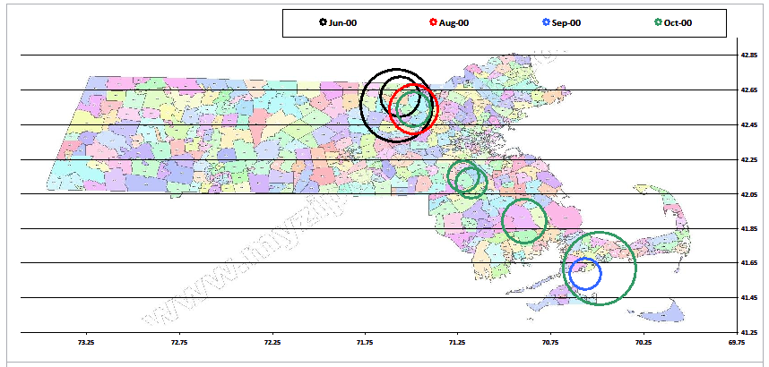
Spatial-Temporal Analysis
Layered snapshots result in cylindrical search areas
Color-coded results for most significant clusters

Slide 24
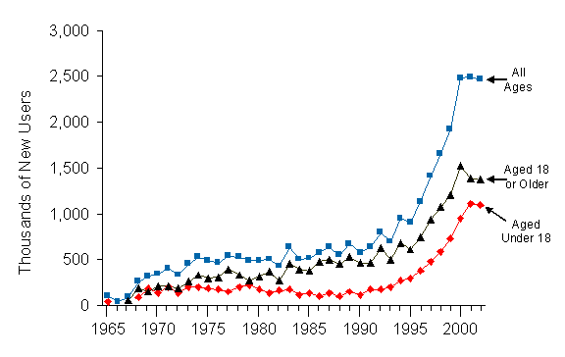
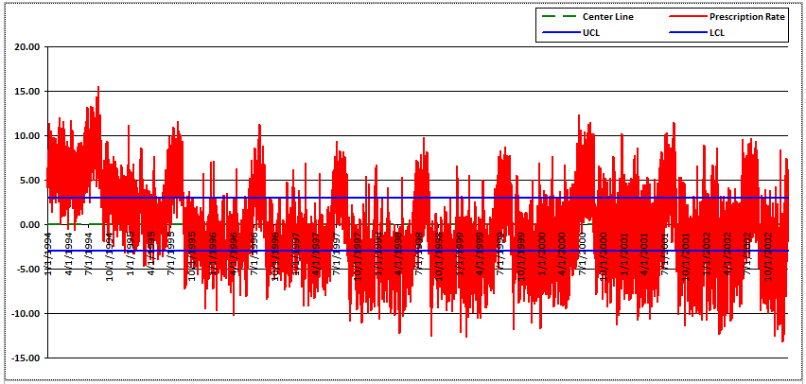
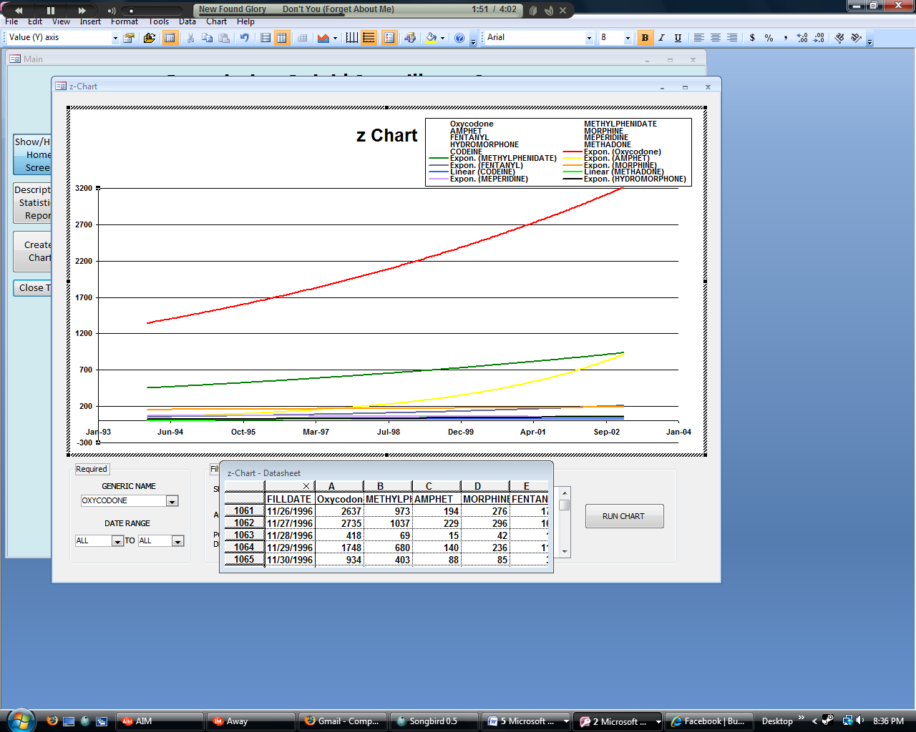
Verification and Validation
Number of New Users for
Nonmedical Use of Pain Relievers
National Survey on Drug Use and Health, 2003
Opioid Prescription Rate
Our Results, 1994-2002
Number of Oxycodone Prescriptions
Our Results, 1994-2002
Data seems to indicate a methodological shift in acquisition of prescription pain relievers
Addition of new drugs to the market also can affect the sensitivity of the results
Oxycodone

Slide 25
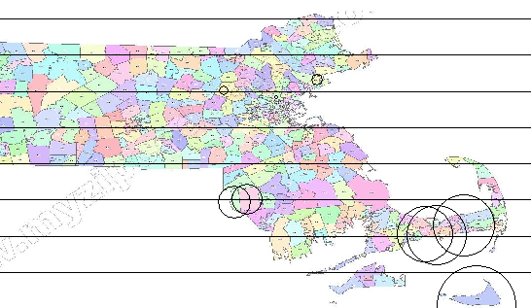
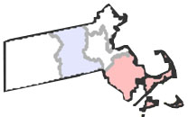
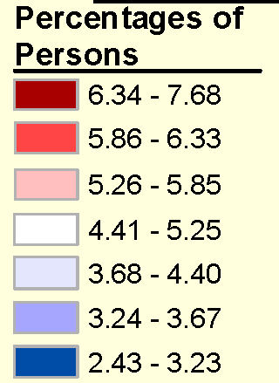
Verification and Validation
Average Percentage of Persons using Pain Relievers Nonmedically
National Survey on Drug Use and Health, 2006
Spatial Analysis, 2002
Our Results
Southeastern MA and the Boston area have the highest percent of persons who abuse prescription drugs.
Detected clusters in southeastern MA and Boston area

Slide 26
Conclusions
Prescription Drug Surveillance System Advantages:
Monitor prescription drug data over time by various SPC methods
Monitor prescription drug data over space and time through advanced cluster detection algorithms
Automatically signal change in the data trends
Allow the user to filter out irrelevant data
Has a user-friendly interface

Slide 27
Future Improvements
More efficiency in VBA programming
GUI testing with persons in MA public health
Use of multivariate control charts
A clear result graph for the 3D SCAN
Ability to run an automated complete analysis of all data combinations
Scheduled automation of PMP data import
Ability to integrate other data streams into the system

Slide 28
Questions?
Thank you!

